Slide 1
Reproducible data analysis
Mark Ewing

Slide 2
Introduction to R

Slide 3

What is R?
Free and open-source software
Free as in speech
Free as in beer
Statistical Programming Language
One of the most popular programming languages in the world

Slide 4

Why use Rstudio?
Integrated development environment
Syntax highlighting
Error warnings
Auto completion
Visual environments
Free as in beer*

Slide 5
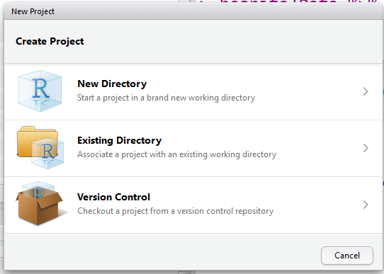
Projects in Rstudio
Projects help you keep everything organized
Critical to achieving reproducible analysis

Slide 6
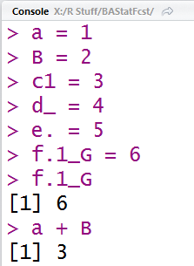
Variables in R
Must begin with a letter
May contain numbers, ‘_’ and ‘.’
Case sensitive
Use <- or = to assign names to values
Variables do not have a type
Functions and variables can have the same name – R will intuit which one you want based on how you use it

Slide 7
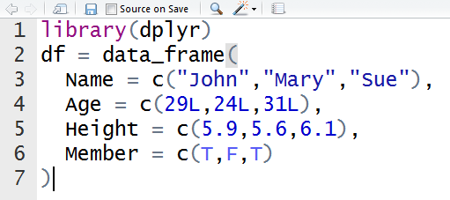
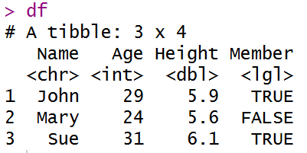
Data storage in R
Tables of data can be stored in data frames
Data frames have columns and rows
A column has only one type of data (numbers, letters, etc.)
Columns have names – rows do not

Slide 8
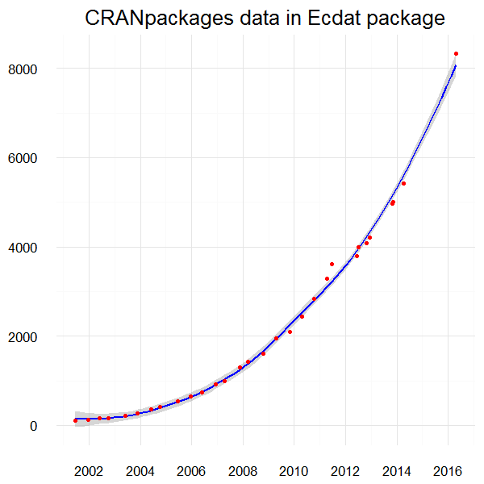
Libraries / Packages
Library means the same thing as Package as far as we’re concerned
Packages contain pre-built functions that make certain tasks easier in R
Sometimes they make R faster
Packages are built by volunteers
Packages are FOSS
Free as in beer
Free as in speech
install.packages(“packagename”)

Slide 9
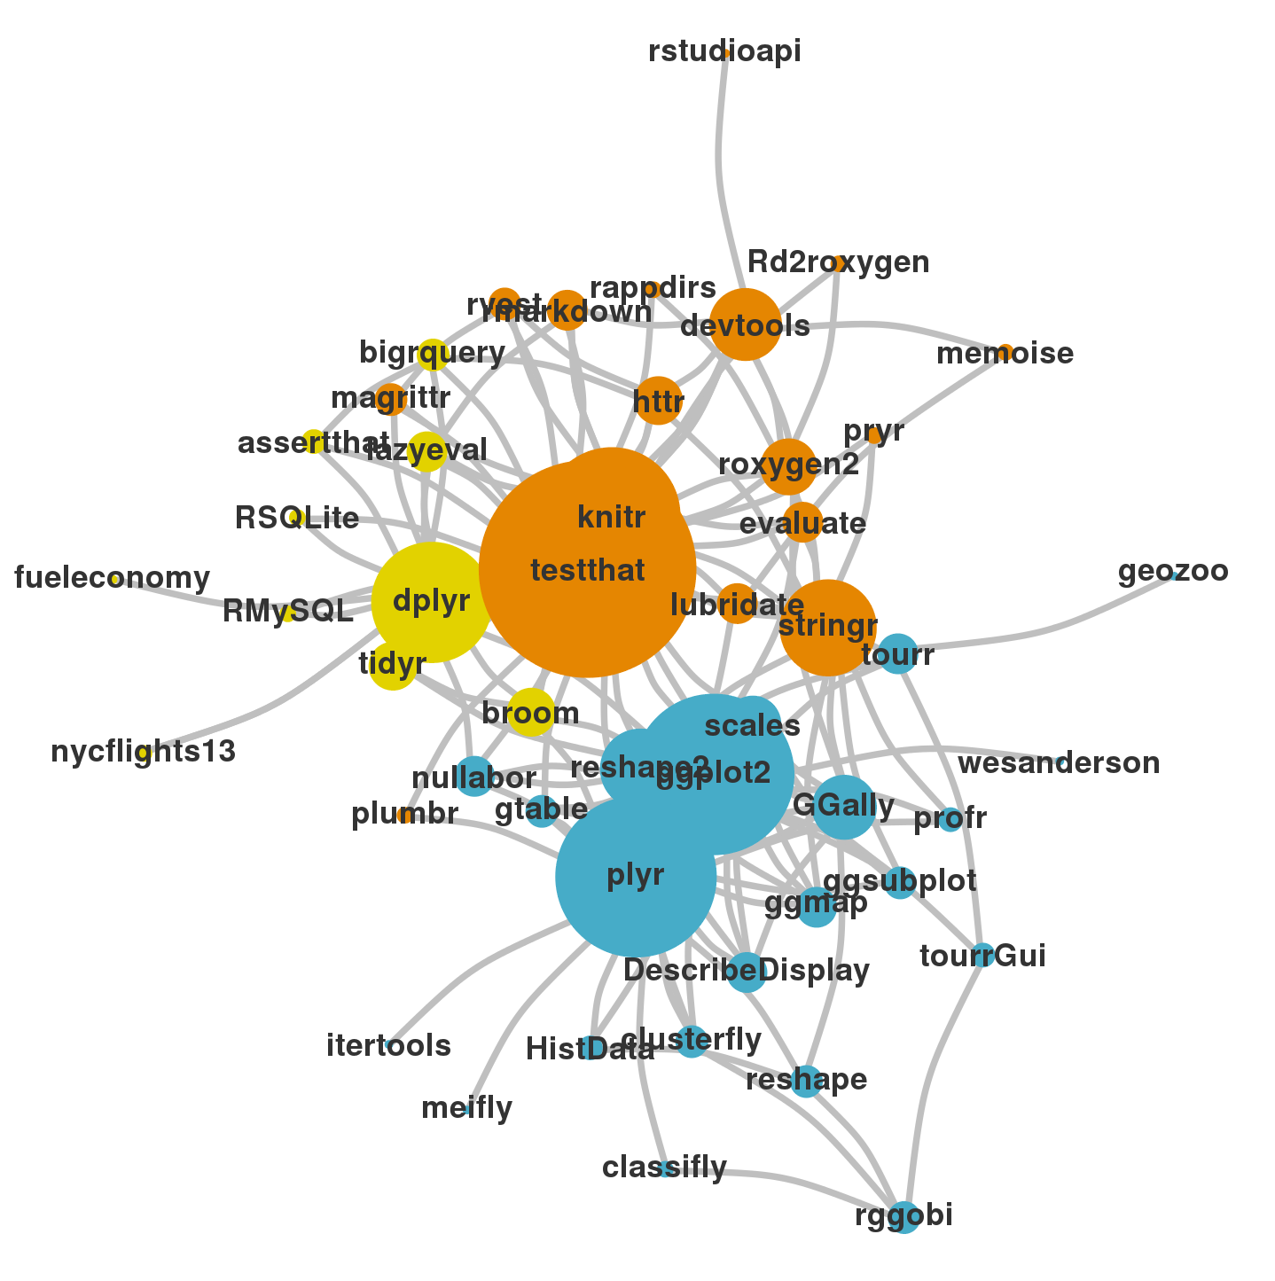
Hadleyverse
Hadley Wickham is a prolific package developer
Works for RStudio
His big focus is ease of data manipulation and visualization
His packages will be the focus of the workshop

Slide 10
Importing data to R

Slide 11
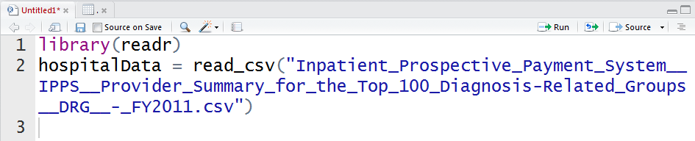
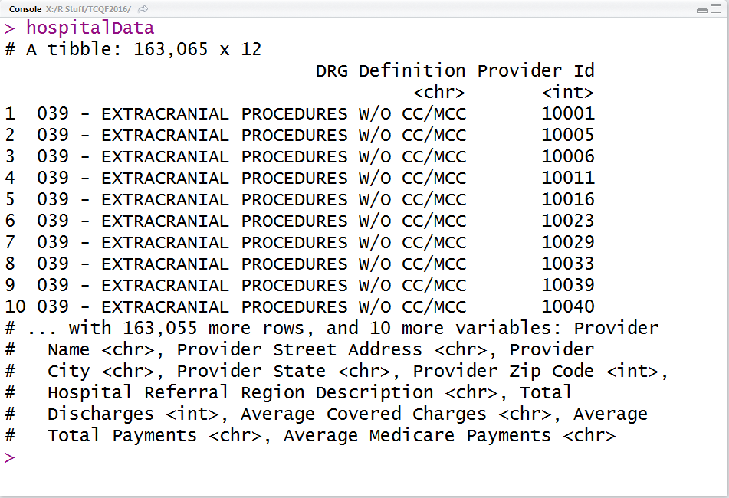
readr
Provides fast method for reading and writing in a variety of file types
read_csv
read_tsv
read_table
read_delim
Guesses at the type of data in each column but also provides the ability to specify column types
?read_csv

Slide 12

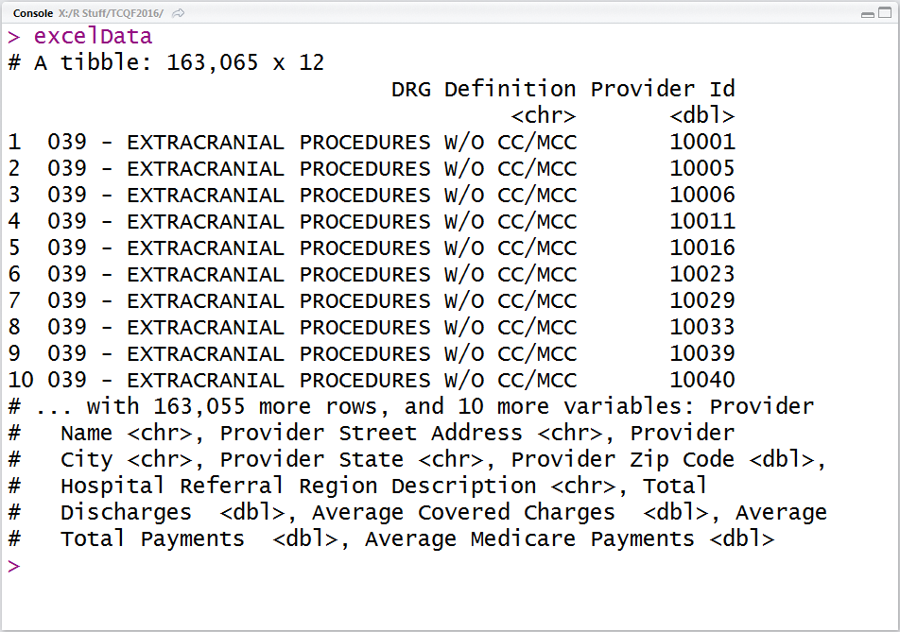
readxl
Provides function to read in .xls and .xlsx files
read_excel
Specify the column types or let the package guess
Specify the sheet by name or index
?read_excel

Slide 13
Managing data in R

Slide 14
dplyr

